Slide 1
Appendix: Steps in Modeling Stage: The System Evaluation Protocol
William M. Trochim
Cornell University
Addendum
prepared for the
National Centre for External
Evaluation of Education (NCEEE)
May 23, 2019
Zagreb, Croatia

Slide 2
Modeling Stage Steps
Stakeholder Analysis
Intro to Modeling
Program Review
Program Boundary Analysis
Lifecycle Analysis
Logic Model
Pathway Model
Evaluation Scope
Program-System Links
Program Model Synthesis

Slide 3
Stakeholder Analysis
Stakeholder Mapping
Other Youth Programs
NYS 4-H
SUNY Morrisville Cobleskill
Cornell University
Local School Districts
Taxpayers
CCE Staff
Youth
Funders
JCADCA
4-H Program
Volunteers
Parents
NYS Jr. Holstein Association
Local Ag Businesses
FFA Teachers
Breed Associations
CCE Board of Directors
4-H Members
National Dairy Industry
Jefferson County Fair Board
Surrounding County Youth
Jefferson County Dairy Producers
State Fair
Jefferson County Legislatures
Media
Stakeholder Map
Notes:
We invite EP participants to cast a “wide net” when thinking about stakeholders – those who care about (or would care if they knew about) the program.

Slide 4
Boundary Analysis
“Everything is vague to a degree you do not realize till you have tried to make it precise” -- Bertrand Russell, 1918
EERS2015 // 4

Slide 5
Boundary Analysis
Boundary Analysis: things to consider
What elements of the program do you influence or control?
How much time and resources are available to you?
Are there additional benefits beyond evaluation?
What kinds of claims do you want to be able to make later?
What would your stakeholders say?

Slide 6
Characterizing a Program’s Evolution
Lifecycle Analysis
Initiation
Development
Stability
Dissemination
Phase 1
Phase 2
Phase 3
Phase 4
State of the Program
Program evolution is a continuous dynamic process

Slide 7
Program Evaluation Lifecycle Phases
Lifecycle Analysis
Process &
Response
Comparison &
Control
Change
Generalizability
Phase 1
Phase 2
Phase 3
Phase 4
State of the Evaluation
Evaluation is a continuous dynamic process

Slide 8
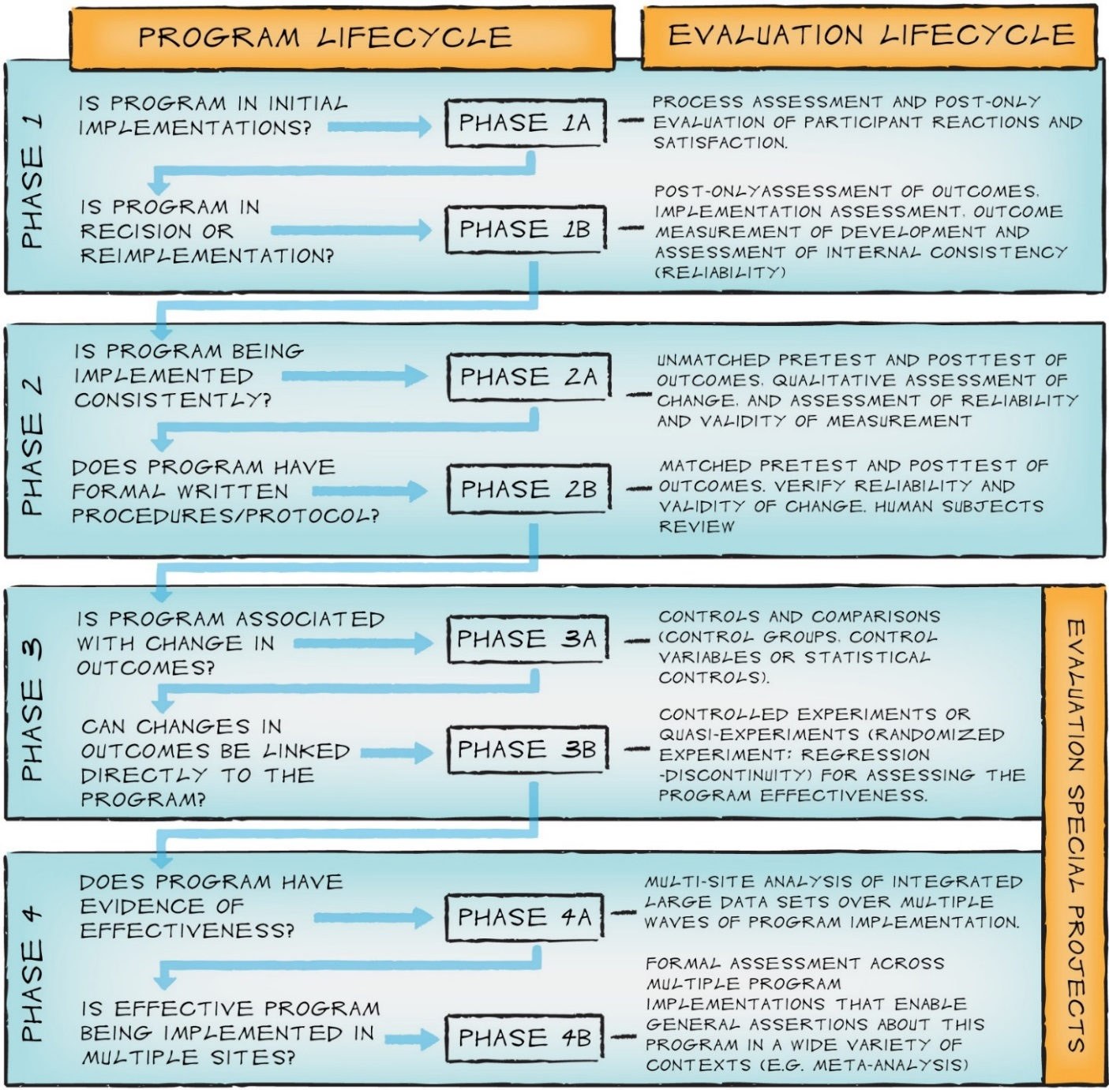
Program and Evaluation Lifecycles: Definitions and Alignment
Lifecycle Analysis

Slide 9
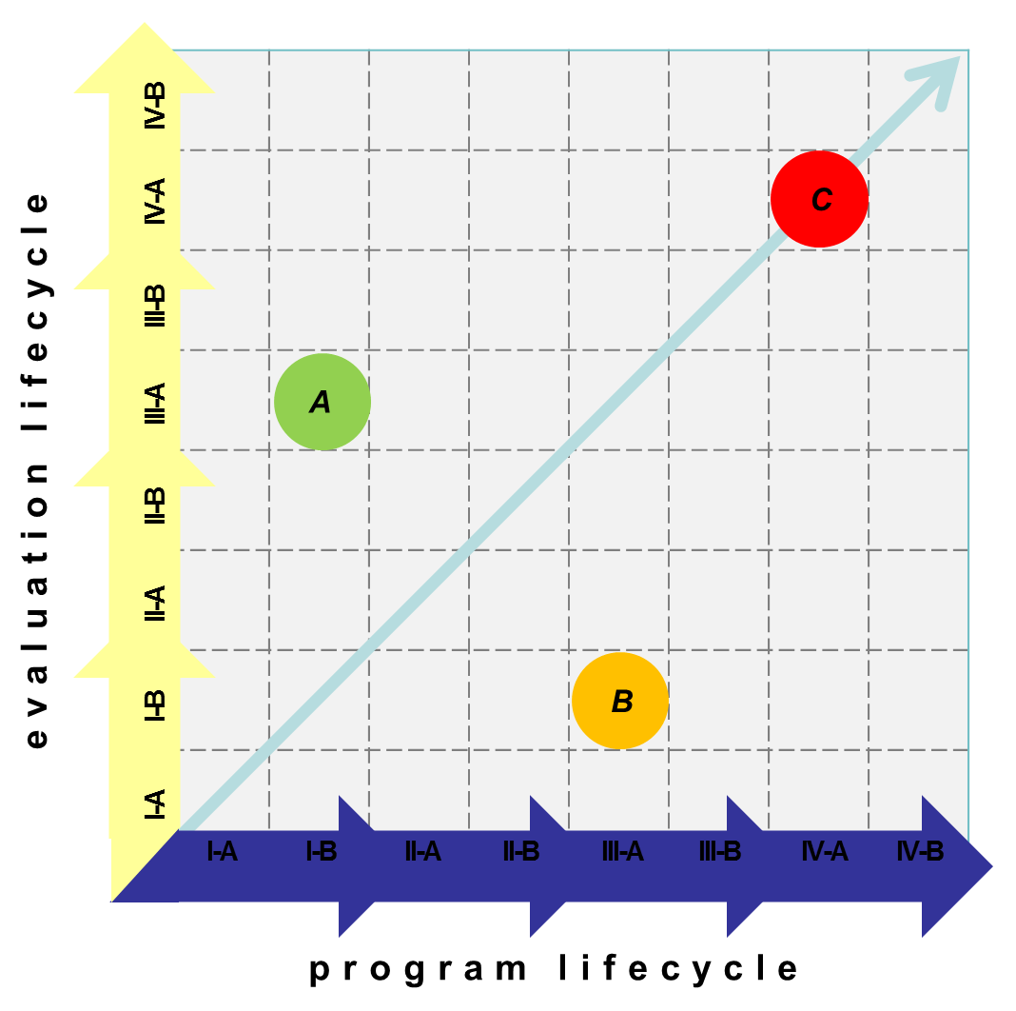
Alignment of Program and Evaluation Lifecycles
Lifecycle Analysis

Slide 10
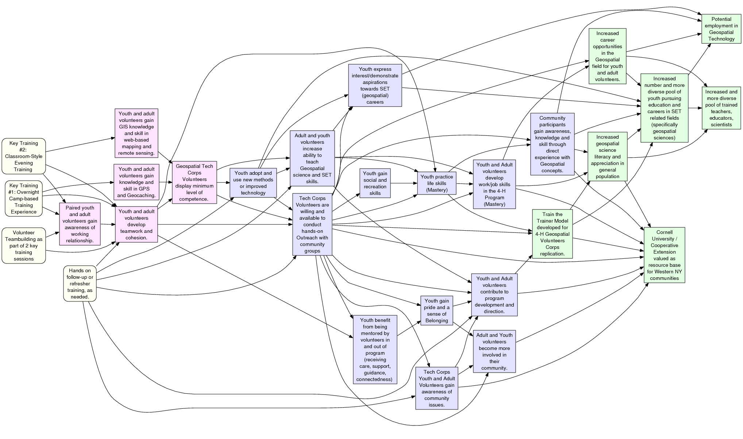
Evaluation Scope
Evaluation Phase 1: Implementation Assessment
Evaluation Phase 2: Awareness & Knowledge
Evaluation Phase 3: Skill & Use
Evaluation Phase 4: Teaching & Outreach
Activities
Short Term Outcomes
Mid Term Outcomes
Long-Term Outcomes
CCE Genesee County: 4-H Geospatial Technology Corps Program
Pathway Model, May 2011

Slide 11
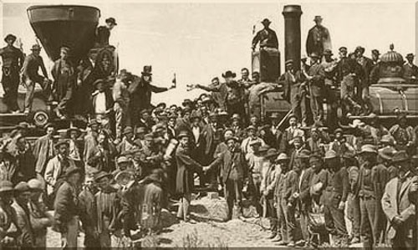
Linking Research and Practice
Program-System Links
Increased rates of higher education & career goal attainment
Students complete engineering kits
Youth interest in science
Increased interest in science education
Linking Evidence to Practice: Finding the “Golden Spike”

Slide 12
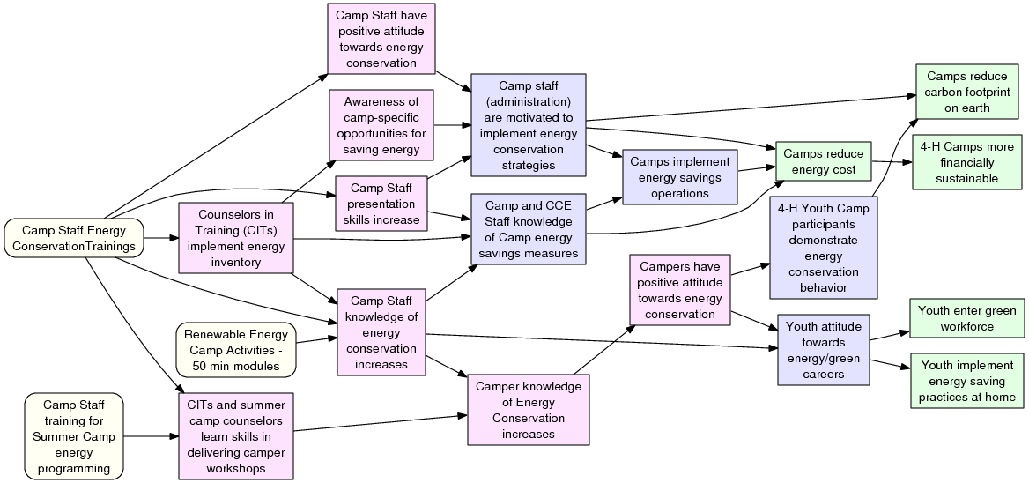
The “Throughline” Story
Program-System Links
Activities
Short Term Outcomes
From Netway, May 24, 2011
Mid Term Outcomes
Long-Term Outcomes

Slide 13
Program-System Links
Experiential Learning Curricular Development Model
for Stimulating Student Interest in Green Collar
Careers (2011) Arnett, Sally E.; Kitchel, Allen; and
Cannon, John G. Online Journal for Workforce
Education and Development: Vol. 5: Issue 1
Putting Renewables and Energy Efficiency to Work:
How many jobs can the clean energy industry generate
in the US? (2010) Wei, Max, Patadia, Shana, and
Daniel M. Kammen Energy Policy Vol. 38 Issue 2 pp. 919-931
Preparing the Workforce for a ‘Greens Job’ Economy (2009) Clearly, Jennifer and Allison Kopicki. John J. Heldrich Center for Workforce Development Research Brief, February 2009.
Energy literacy of secondary students in New York State (USA): A measure of knowledge, affect, and behavior. (2010) DeWaters, Jan and Susan Powers. Energy Policy. Vol 39: 1699-1710. 2010.
Learners and Learning in Environmental Education: A Critical Review of the Evidence (2010) Rickinson, Mark. Environmental Education Research, July 2010.
Energy Education Professional Development: Assessment of Teachers’ Satisfaction (2009) Theresa M. Ford, Masters’ Thesis, Univ. of Wisconsin July 2009

Slide 14
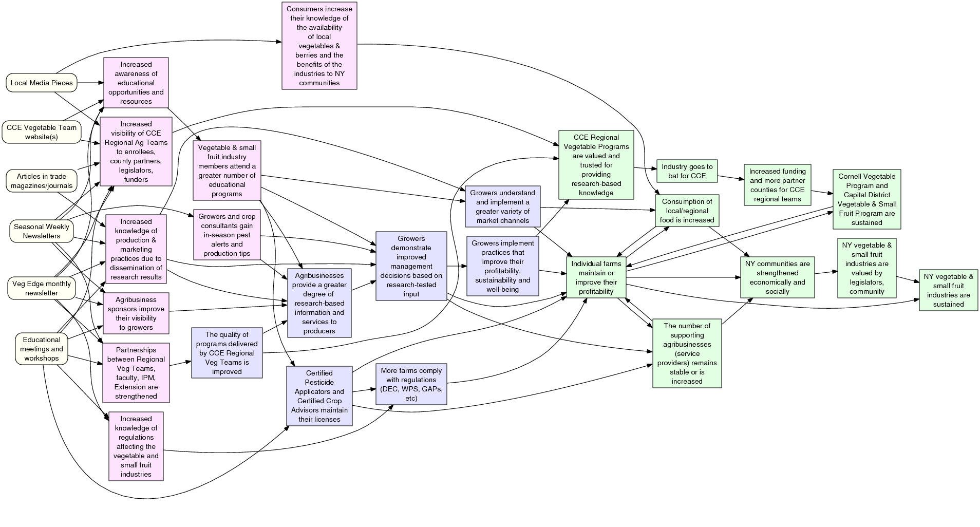
Focusing the Evaluation
Developing Evaluation Questions
EQ: How do newsletter readers rate their level of knowledge about
Research trials
Rules and regulations
Insects, diseases, and weeds
Emerging issues
Marketing issues
Activities
Short Term Outcomes
Mid Term Outcomes
Long-Term Outcomes
CCE Regional Vegetable Program: Broad Outreach Program
Pathway Model

Slide 15
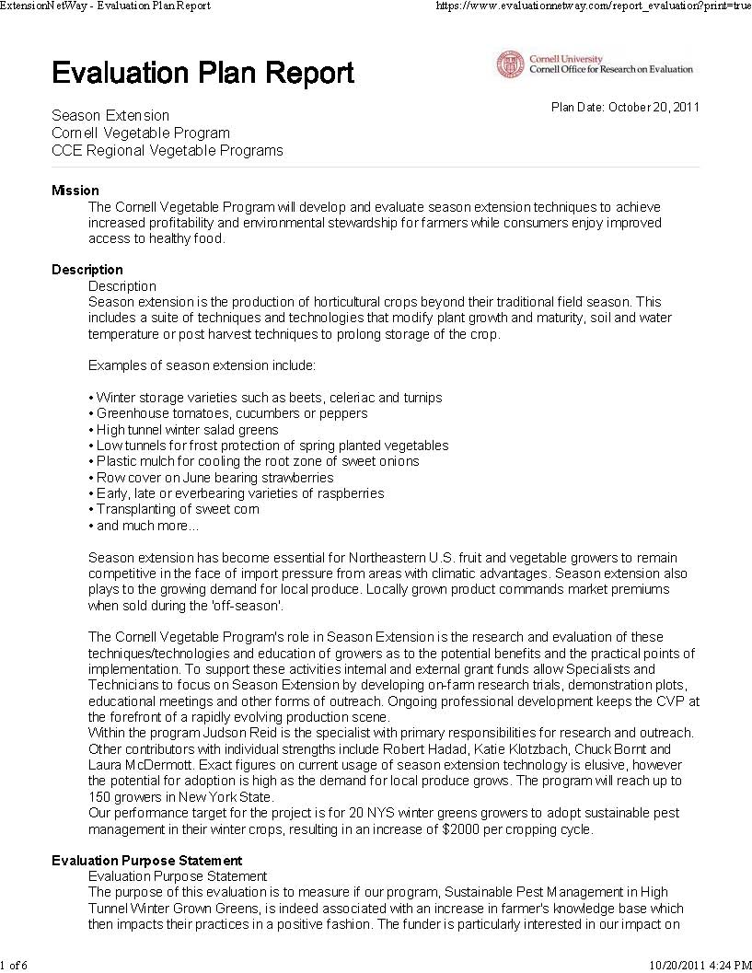
Evaluation Plan Outline
Developing the Evaluation Plan
Program Mission
Program Description
Evaluation Purpose Stmt
Evaluation Questions
Sampling Plan
Measures
Evaluation Design
Data Management
Analysis
Reporting
Timeline

Slide 16
For further information
William Trochim
Cornell University
wmt1@cornell.edu
https://core.human.cornell.edu/

